Slide 1

ANDHRA LOYOLA INSTITUTE OF ENGINEERING AND TECHNOLOGY
  (Approved by AICTE & Affiliated to JNTUK, Kakinada)
An ISO 9001-2015 Certified institution
VIJAYAWADA-52008
DEPARTMENT OF ELECTRONICS AND COMMUNICATION ENGINEERING
Title : IoT and Machine Learning Based Smart Health Monitoring System
Guide
Mr .P. BOSE BABU
M.Tech.,(Ph.D)
Submitted By
S.GEETHIKA (22HP1A0468)

Slide 2
CONTENTS
PROBLEM STATEMENT
ABSTRACT
INTRODUCTION
PROJECT OBJECTIVE
BLOCK DIAGRAM
SENSORS USED
HARDWARE COMPONENTS
SOFTWARE COMPONENTS
METHODOLOGY
WORKING STEPS
HARDWARE
RESULTS
ADVANTAGES
CONCLUSION
FUTURE SCOPE
REFERENCES

Slide 3
PROBLEM STATEMENT
Cardiovascular diseases are a major cause of death worldwide, so continuous monitoring of health parameters like heart rate, SpO₂, and body temperature is very important. Traditional systems are expensive, hospital-based and cannot provide continuous monitoring. Most current systems use only simple threshold-based alerts without intelligent analysis. Therefore, a smart IoT-based healthcare system with Machine Learning is needed to monitor, store, and analyze patient data in real time.

Slide 4
ABSTRACT
This project presents an intelligent healthcare solution that combines Internet of Things (IoT) technology with Machine Learning to enable continuous monitoring of patient health conditions. The system collects vital parameters such as heart rate, oxygen saturation, body temperature, and environmental conditions using multiple sensors. These parameters are processed and transmitted to a cloud platform for remote access.
Unlike conventional monitoring systems, this model provides real-time data analysis and classification of patient health status using a trained machine learning algorithm. The system can automatically identify abnormal conditions and generate alerts, ensuring timely medical response. The proposed solution is cost-effective, portable, and suitable for home-based healthcare, especially for elderly individuals and patients requiring constant observation

Slide 5
Introduction
In recent years, advancements in embedded systems and communication technologies have transformed the healthcare domain by enabling smarter and more efficient monitoring solutions. Continuous observation of vital health parameters is essential for preventing serious medical conditions, particularly in patients with chronic diseases.
Traditional monitoring systems are limited by location, cost, and the need for manual supervision. To overcome these challenges, modern systems utilize IoT devices that can collect and transmit health data in real time. By integrating machine learning techniques, these systems can also analyze patterns and predict potential health risks.
This project focuses on developing a smart health monitoring system that operates both locally and remotely. It enhances patient care by providing real-time insights, reducing hospital dependency, and supporting early diagnosis through intelligent data analysis.

Slide 6
PROJECT OBJECTIVE
The Internet of Things (IoT) has enabled smart healthcare systems that allow continuous monitoring of patient health parameters. Traditional monitoring methods require frequent hospital visits and do not provide real-time remote monitoring. This project develops an IoT and Machine Learning based Smart Health Monitoring System using Arduino and ESP32 to monitor parameters such as heart rate, SpO₂, body temperature, and environmental conditions. The collected data is sent to the cloud for remote monitoring and analyzed using Machine Learning to detect abnormal health conditions. This system helps in early detection of health issues and improves patient safety

Slide 7
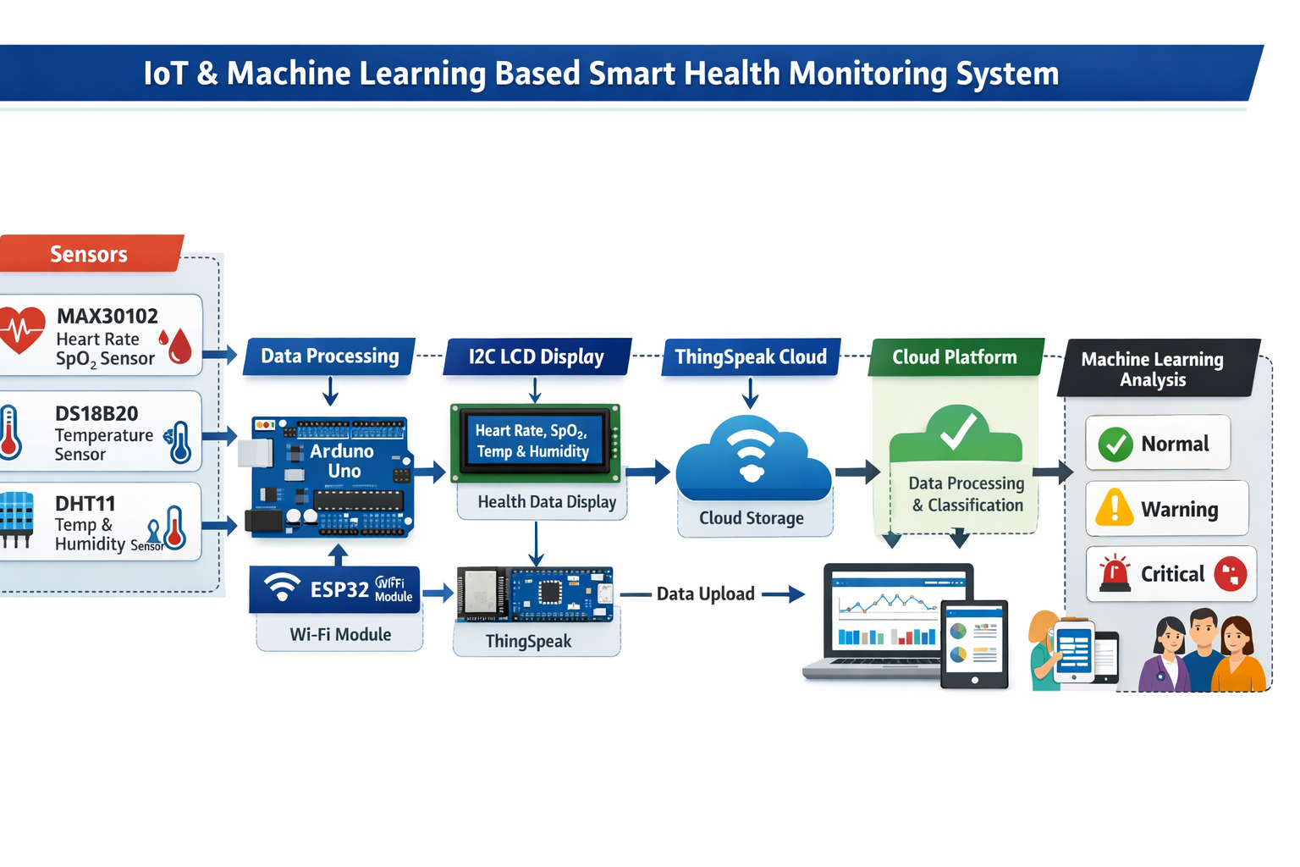
BLOCK DIAGRAM

Slide 8
SENSORS USED
MAX30102 Sensor: Used to measure heart rate and blood oxygen saturation (SpO₂). It uses infrared and red light technology to detect pulse rate and oxygen levels in the blood. Helps in monitoring cardiovascular health and detecting abnormal heart rate conditions.
DS18B20 Sensor: A digital temperature sensor used to measure the patient’s body temperature with high accuracy. Provides reliable and precise temperature readings and easily interfaces with microcontrollers like Arduino.
DHT11 Sensor: Used to measure environmental parameters such as room temperature and humidity. Helps in monitoring the surrounding environment to ensure a comfortable and safe condition for the patient.
These sensors together enable multi-parameter monitoring in the smart health monitoring system. Sensor data is collected by the Arduino microcontroller and used for real-time health analysis.

Slide 9
HARDWARE COMPONENTS
• ESP32 Wi-Fi Module:
Provides wireless internet connectivity to the system. It enables the transmission of collected sensor data to the cloud platform for remote monitoring. It IoT applications by allowing real-time data communication through Wi-Fi networks.
SIM900 GSM Module :
The SIM900 GSM Module is a widely used GSM/GPRS module that enables devices to communicate over a mobile network. It acts like a mini mobile phone that can send SMS, make calls, and access the internet.
• MAX30102 Sensor:
Used to measure important physiological parameters such as heart rate and blood oxygen saturation (SpO₂).
• DS18B20 Temperature Sensor:
Measures the body temperature of the patient high precision and provides digital output to the microcontroller.
• DHT11 Sensor:
Monitors environmental parameters such as room temperature and humidity to ensure a comfortable environment for the patient.

Slide 10
• I2C LCD Display:
Displays the real-time health parameters such as heart rate, SpO₂ levels, and temperature values directly on the device.
• GCB and Jumper Wires:
Used for making Permenant connections between electronic components during circuit implementation and testing.
• Power Supply (5V):
Provides the necessary electrical power required for the operation of the microcontroller, sensors, and other hardware components in the system.

Slide 11
SOFTWARE COMPONENTS
Software Components
• Arduino IDE
Used for writing, compiling, and uploading programs to the Arduino Uno and ESP32 modules. It provides the development environment for embedded system programming.
• Embedded C Programming:
The system is programmed using Embedded C language to control sensors, process data, and manage communication between hardware components.
• ThingSpeak Cloud Platform:
Used for storing, analyzing, and visualizing the sensor data on the cloud. It allows remote monitoring of patient health parameters through internet connectivity.
• Machine Learning Algorithm:
Used to analyze the collected health data and classify the patient’s condition into categories such as Normal or Critical.

Slide 12
METHODOLOGY
The proposed system is designed using a structured approach that integrates hardware, software, and data analysis components.
Initially, biomedical sensors are used to capture physiological parameters such as heart rate, oxygen level, and body temperature. Environmental data like room temperature and humidity are also recorded. These sensors are interfaced with a microcontroller that processes the collected signals into meaningful values.
Next, the processed data is displayed locally on an LCD for immediate observation. Simultaneously, the data is transmitted to a cloud platform using a wireless communication module. This enables remote monitoring by doctors and caregivers.
Further, the collected data is fed into a machine learning model, which analyzes patterns and classifies the patient’s health condition into predefined categories. Based on the analysis, the system can trigger alerts when abnormal conditions are detected.
The methodology ensures continuous monitoring, intelligent decision-making, and remote accessibility in a unified system.

Slide 13
WORKING STEPS
1. System Initialization
All components like sensors, ESP32, LCD, and communication modules are powered and configured. The system checks connections and prepares protocols for proper operation.
2. Data Acquisition from Sensors
Sensors collect real-time data such as heart rate, SpO₂, body temperature, and humidity. These values are captured continuously in raw form for further processing.
3. Signal Processing by Microcontroller
The microcontroller converts raw sensor data into meaningful digital values. It applies calculations and filtering to produce accurate health parameters.
4. Real-Time Data Display (LCD Output)
Processed data is displayed on the LCD screen for instant view. We can monitor health parameters directly without internet access.
5. Data Transmission using IoT
The ESP32 sends collected data to the cloud via Wi-Fi connection.
This enables remote monitoring from anywhere using internet access.

Slide 14
6. Cloud Storage and Visualization
The data is stored in the cloud with date and time details. Graphs and charts are generated to visualize health trends clearly.
7. Machine Learning Data Analysis
The ML model analyzes sensor data to detect patterns and abnormalities. It improves accuracy by learning from previous health data.
8. Health Condition Classification
The system categorizes patient condition as normal, warning, or critical. This helps in quick understanding of the patient’s health status.
9. Alert and Notification System
Alerts are sent via SMS or notifications when abnormal values are detected. This ensures immediate action from caregivers or doctors.
10. Continuous Monitoring Loop
The system continuously repeats all steps for real-time tracking. It provides 24/7 monitoring for better patient safety.

Slide 15
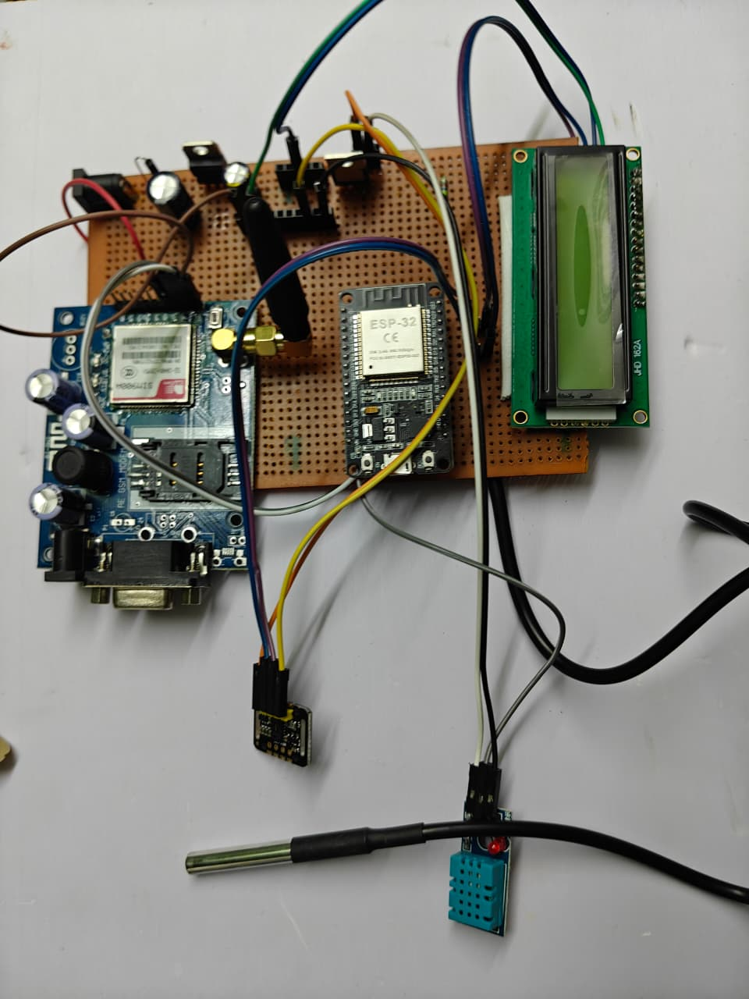
HARDWARE

Slide 16
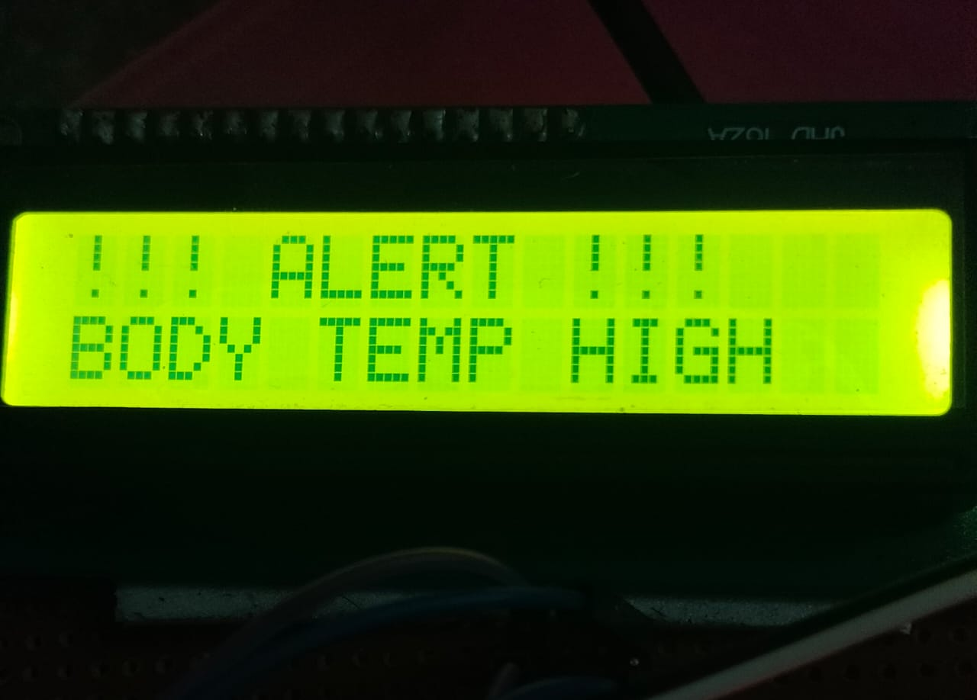
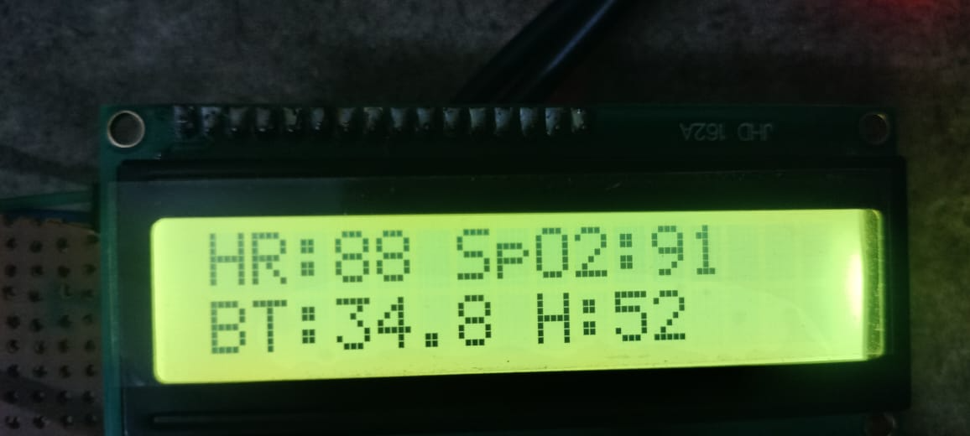
RESULTS

Slide 17
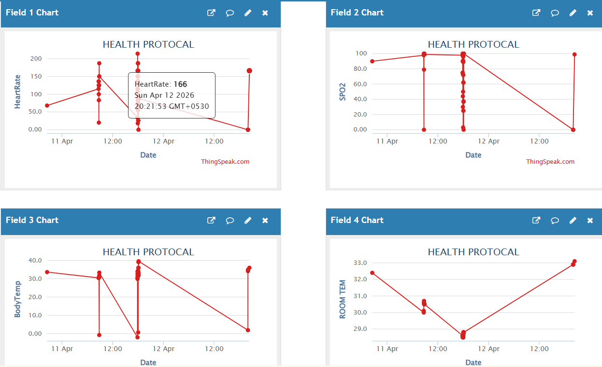
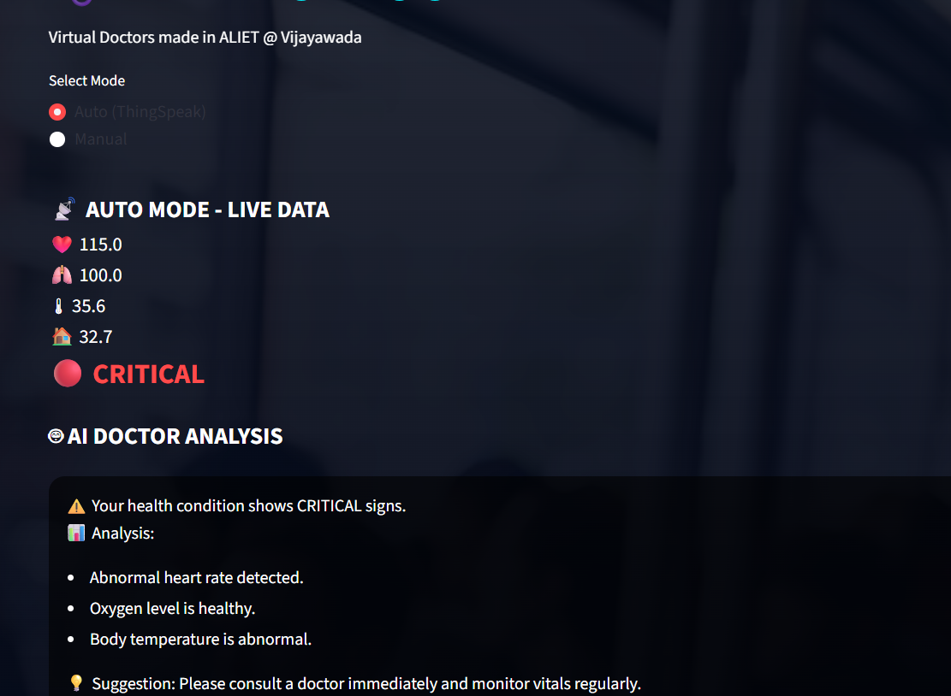
CONT……

Slide 18
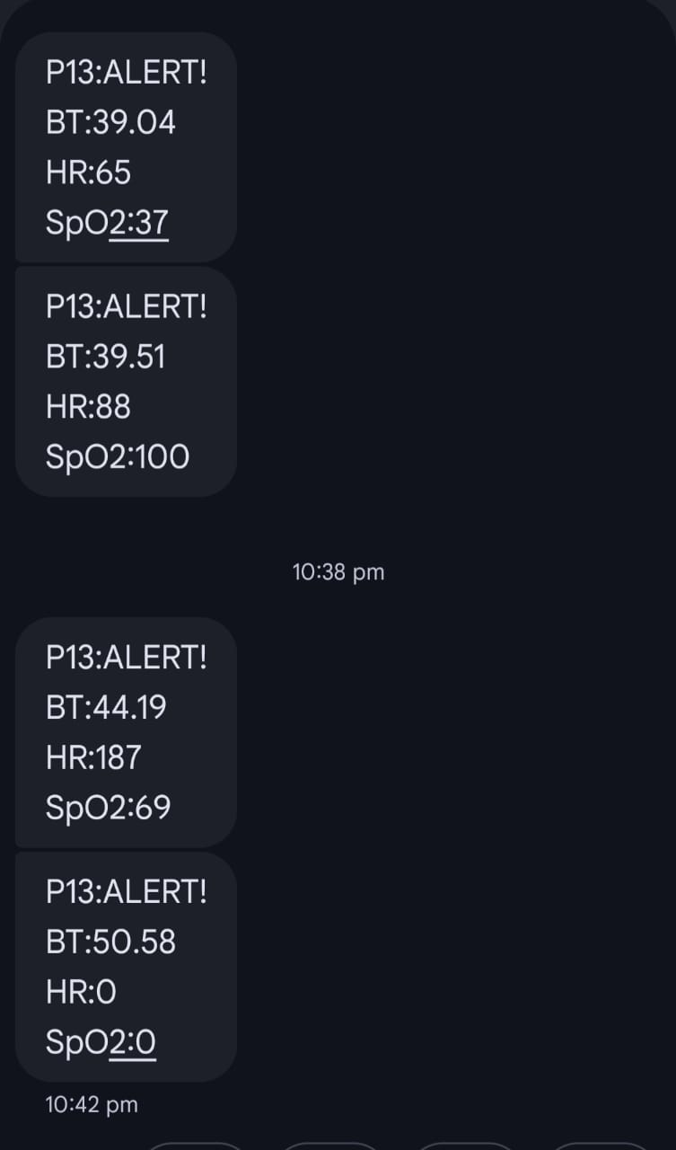
CONT…

Slide 19
ADVANTAGES
• Supports multi-parameter health monitoring.
• Measures heart rate, SpO₂, body temperature, and environmental conditions.
• Uses IoT technology for real-time cloud monitoring.
• Data is stored on the ThingSpeak cloud platform.
• Provides remote monitoring for doctors and caregivers.
• Machine Learning is used for intelligent health analysis.
• Early detection of abnormal health conditions.
• Low-cost and portable healthcare solution.

Slide 20
APPLICATIONS
• Remote patient health monitoring.
• Home healthcare monitoring systems.
• Elderly patient monitoring.
• Smart hospitals and healthcare centers.
• Continuous monitoring of chronic patients.
• Emergency health monitoring systems.
• Rural and remote healthcare services.
• Personal health monitoring devices.

Slide 21
FUTURE SCOPE
• Integration with mobile health applications.
• Advanced AI-based disease prediction systems.
• Integration with hospital database systems.
• Development of wearable healthcare devices.
• Real-time doctor notification systems.
• Improved data security and privacy mechanisms.
• Large-scale healthcare monitoring networks.

Slide 22
CONCLUSION
The proposed IoT and Machine Learning based Smart Health Monitoring System provides an efficient solution for continuous monitoring of important health parameters. The system uses sensors to measure heart rate, blood oxygen saturation (SpO₂), body temperature, and environmental conditions. These parameters are processed by the Arduino microcontroller and transmitted to the cloud using the ESP32 WiFi module. The data can be monitored remotely by doctors and caregivers through the cloud platform. Machine Learning techniques are used to analyze the collected data and classify the patient’s health condition as normal, warning, or critical. This helps in early detection of health abnormalities and improves patient safety. The system is low-cost, portable, and suitable for home healthcare and remote patient monitoring. By integrating IoT and Machine Learning, the system enhances the efficiency and reliability of modern healthcare monitoring systems.

Slide 23
REFERENCES
Gupta, A., Singh, R., & Kumar, P., “IoT-Based Smart Healthcare Monitoring System Using Wearable Sensors,” Proceedings of IEEE International Conference on Smart Computing and Electronic Enterprise (ICSCEE), 2023.
Khan, M., Ahmed, S., & Ali, T., “Real-Time IoT-Based Patient Health Monitoring System Using Cloud Computing,” IEEE International Conference on Internet of Things and Intelligence System (IoTaIS), 2023.
Patel, D., & Shah, H., “Smart Health Monitoring System Using IoT and Machine Learning,” IEEE International Conference on Artificial Intelligence and Smart Systems (ICAISS), 2024.
Chatterjee, S., Roy, A., & Mukherjee, S., “AI-Enabled IoT Framework for Remote Healthcare Monitoring,” IEEE Access, vol. 12, pp. 45520–45535, 2024.
Ramesh, S., & Prakash, V., “Intelligent IoT-Based Healthcare Monitoring System Using Edge Computing,” IEEE International Conference on Smart Internet of Things (SmartIoT), 2025.

Slide 24
THANK YOU

